Slide 1
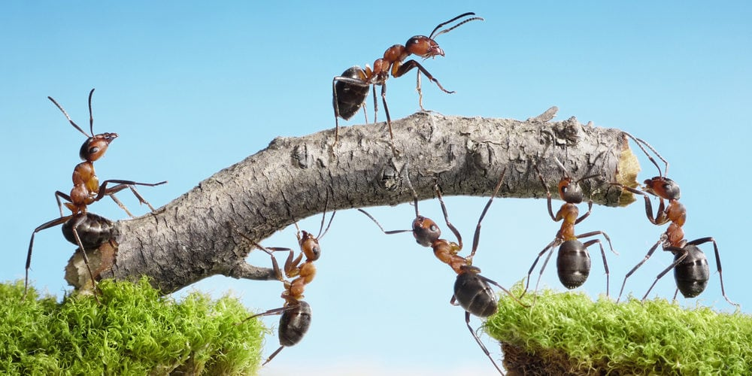
Teams for Teamwork “Working in a team encourages personal growth, increases satisfaction, and reduces stress.”
Sanjeeva Perera
Senior Academic Fellow - Faculty of Computing

Slide 2
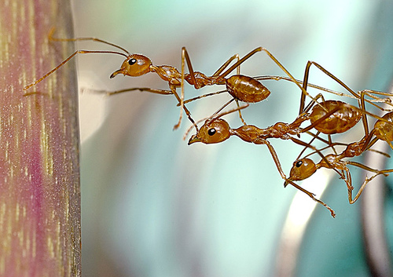
What is a team ?
“Team is a group of people who are interdependent with respect to information, resources, knowledge and skills and who seek to combine their efforts to achieve a common goal” Professor Leigh Thompson
“A team is a group of people working toward a common goal.”

Slide 3
The Nature of a Team
What is the difference between Groups and Team ?
A working group’s performance is a function of what its members do as individuals.
A Team’s performance includes both individual results and what we call “collective work products”
Video – Group vs Team

Slide 4
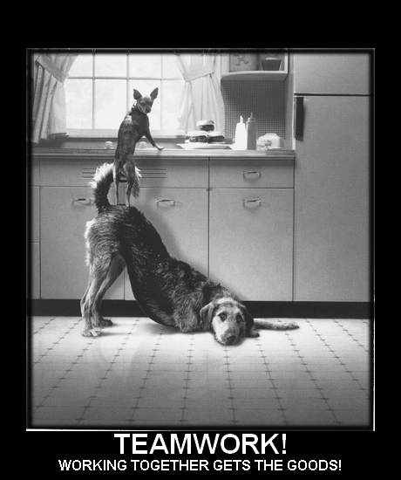
Professional Skills
Lecture 4 - Teams for Teamwork
Meircats Work Together – Video
e.g. from animal world

Slide 5
A team can be..
Large – (20-30)
Ex: IT Department Lecturers, Senate
Small - (2-5)
Ex: Board of Directors, Surgeons of a surgery
Short Term
Ex: event committee
Long Term
Ex: Parliament standing committee for Public Relations

Slide 6
Team Development Stages
There are five stages to group development
Forming
Storming
Norming
Performing
Adjourning
- Dr. Bruce Tuckman

Slide 7
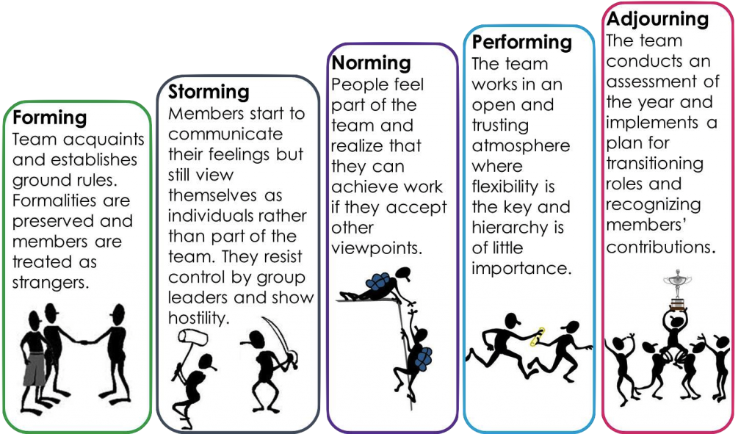
Team Development Stages Bruce Tuckman (1965) five stages of team development

Slide 8

What is a Team Role?
A Team Role came to be defined as:
“A tendency to behave, contribute and interrelate with others in a particular way.”
-Dr Meredith Belbin

Slide 9
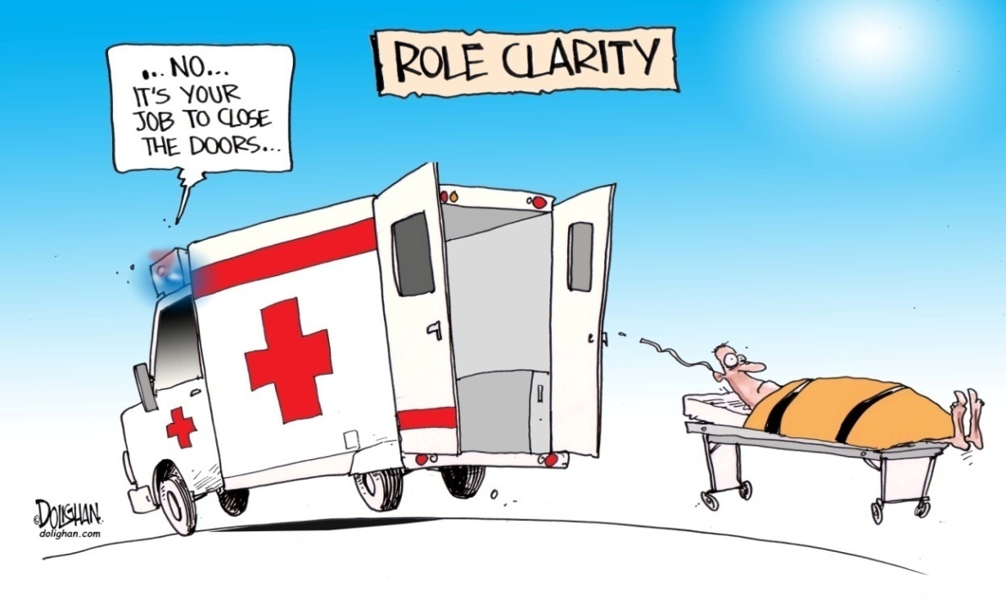

Role

Slide 10
Role
Set of behaviors required or expected of the person occupying a certain position in a group.
There are two types of roles :
Formal Role - dictated by the structure of the organizations (coach, team captain).
Informal Role - evolve from the group's dynamics.
Role Acceptance - important to enhance a group’s structure.

Slide 11
Belbin Team Role Theory
Dr R.Meredith Belbin, a British Researcher identified 9 Team Roles
"The types of behaviour in which people engage are infinite. But the range of useful behaviours, which make an effective contribution to team performance, is finite. These behaviours could be grouped into a set number of related clusters to which the term ‘Team Role’ is applied.“
Meredith Belbin | Taken from: Team Roles at Work

Slide 12









Belbin Team Role Theory
The nine team roles
Plant
Monitor Evaluator
Specialist
Coordinators
Resource Investigators
Team workers
Implementers
Shapers
Completer-Finishers
}
Thought Focused Roles
}
People Focused Roles
}
Action Focused Roles

Slide 13
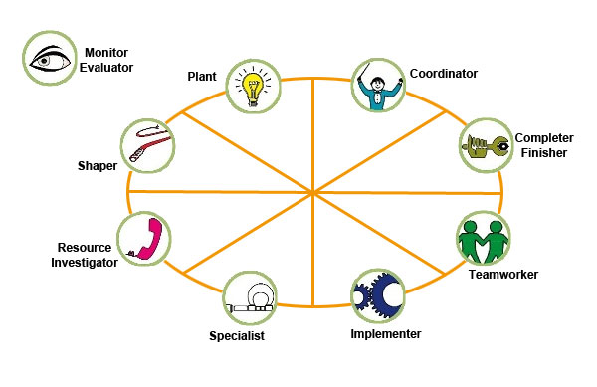
Belbin’s Team Roles
http://www.belbin.com
Notes:
PLANT (PL)
Plants are innovators and inventors and can be highly creative. They provide the source of original ideas to support innovation. Usually they prefer to operate by themselves at some distance from other members of the team, using their imagination and often working in an unorthodox way. They tend to be introverted and react strongly to criticism and praise. Their ideas may often be radical and may lack practical constraint. They are independent, and usually regarded as being clever as a result of their original and radical perspective. They don’t always manage to communicate in a compelling way and offer their ideas in a practical and relevant framework.
Function: The main use of a PL is to challenge conventional and established ways of doing things and provide suggested solutions for solving complex problems. PLs are often needed in the initial stages of a project or when a project is failing to progress. PLs have usually made their mark as founders of companies or as originators of new products. However, too many PLs in one team or group may be counter-productive as they tend to spend their time reinforcing their own ideas and engaging each other in combat.
RESOURCE INVESTIGATOR (RI)
Resource Investigators are usually enthusiastic extroverts. They are natural communicators with people both inside and outside the company. They are natural negotiators and are adept at exploring new opportunities and developing contacts. Although not a great source of original ideas, the RI is effective when it comes to picking up other people's ideas and promoting them. As the name suggests, they are adept at finding out what is available and from whom. RIs are generally relaxed people with a strong inquisitive sense and a readiness to see the possibilities in anything new. However, unless they remain stimulated by others, their enthusiasm can rapidly fade.
Function;
RIs are good at exploring and reporting back on ideas, developments or resources outside their immediate group. They are the natural people to set up external contacts and to carry out any subsequent negotiations. They have an ability to think on their feet and to probe others for information
CO-ORDINATOR (CO)
The distinguishing feature of Co-ordinators is their propensity for helping others to work towards shared goals. Mature, trusting and confident, they delegate readily. In interpersonal relations they are quick to spot individual talents and to use them in pursuit of group objectives. While COs are not necessarily the cleverest or most senior member of a team, they are likely to have a broad outlook and perspective. The natural goal focus of CO’s can sometimes lead to them manipulating others to achieve their personal objectives. In some situations COs are inclined to clash with Shapers due to their contrasting management styles.
Function: COs are well placed when put in charge of a team of people with diverse skills and personal characteristics. They perform better in dealing with colleagues of near or equal rank than in directing junior subordinates. Their motto might well be "consultation with control“ and they usually believe in tackling problems calmly.
SHAPER
Shapers are highly goal oriented people with great drive and energy. They push themselves and others and tend to overcome obstacles by sheer determination. They tend to be highly assertive and have very directive management styles. Shapers also tend to be competitive and like to win. They frequently progress upward in organisations because they get results and because many people are impressed by their courageous and decisive leadership style. SHs are not noted for their interpersonal sensitivities and can be argumentative and even aggressive.
Function:
SHs are generally perceived as ideal managers because they generate action and thrive under pressure. They come into their own when quick and decisive action is called for to overcome threats and difficulties or when progress towards goals and objectives is unacceptably slow.
MONITOR EVALUATOR (ME)
Monitor Evaluators are serious-minded, prudent individuals with a built-in immunity for being over-enthusiastic. They are likely to be slow in making decisions preferring to carefully think things over. Usually they have a high critical thinking ability. They have a good capacity for shrewd judgements that take all factors into account. A good ME is unlikely to make intuitive and reckless mistakes. They deal in facts and logic rather than emotion when considering options. They are often regarded as over-critical and can be seen to be slow and boring.
Function:
MEs are best suited to analysing problems and evaluating ideas and suggestions. They are very good at weighing up the pro's and con's of options. In a managerial position their ability to make high quality decisions consistently is likely to make them highly regarded.
IMPLEMENTER
Implementers are characterised by their practical approach and possess higher than normal levels of self-control and discipline. They are prepared to work hard to ensure things are done as prescribed in a systematic way. They are typically loyal to the organization and prescribed and established ways of doing things. They are likely to be regarded as someone who will not seek personal agendas and self-interest. On the downside IMPs may be inflexible in accepting new ways of doing things, particularly if they are radical or impracticable.
Function:
IMPS are valuable in an organisation because of their reliability and capacity for application. They succeed because they are efficient and because they have a sense of what is feasible and relevant. While many people might stray favouring the tasks they like to do and neglect things they find not to be to their liking an IMP is more likely to do what needs to be done in a systematic and relentless way.
TEAMWORKER (TW)
Teamworkers possess a mild and sociable disposition and are generally supportive and concerned about others. They have a great capacity for flexibility and adapting to different situations and people. TWs are perceptive, diplomatic and caring and tend to be good listeners. Because of these qualities it is hardly surprising that they are popular with their colleagues. Their concern about creating harmony and avoiding conflict can make them indecisive when faced with having to make difficult solo decisions.
Function:
The TW may be legitimately compared to the lubricating oil in a car engine. We don’t always appreciate how important it is until it isn’t there. Because of their ability to be able to resolve interpersonal problems TW’s come into their own when situations are tense and people feel uncared for and not appreciated. They can rise to senior positions because they have few enemies and the fact that they are ready to listen to the views and suggestions of others.
COMPLETER-FINISHER (CF)
Completer Finishers have a great capacity for the attention to detail. They constantly strive for perfection and correct errors. CFs are quite introvert and require less external stimulus than most people. The CF can be trusted to do work to the highest standard and to complete it on time. The combination of striving for perfection and meeting dead lines often creates anxiety though and CFs are likely to be reluctant to trust others to do work to their own high standards.
Function:
The Completer Finisher is invaluable where tasks demand close concentration and a high degree of accuracy. The standards they set make them well suited to situations where precision and high standards are essential. CFs will also demand the same high standards from people around them and therefore create their own micro culture where the only standard acceptable is perfection.
SPECIALIST (SP)
The Specialist Team Role and the functional title of Specialist is often a cause for confusion. While it is true that both uses of the term may relate to people who are a source of technical knowledge and expertise the Specialist in Team Role terms has some very specific attributes. Their main distinguishing feature is their love of learning. They see learning and the accumulation of knowledge as the main reason for their existence and their single minded and resolute pursuit of this end is their main motivation. The SP is likely to be recognised by colleagues as an expert to turn to for help and guidance. The SP will usually try to avoid being involved in unstructured meetings and discussions or those of a social nature. They may also be somewhat unyielding when challenged about the validity of their knowledge or field of expertise.
Function:
While SPs may not be regarded as natural team players teams will be wise to engage the SP as a means of providing in depth research. As managers, they command respect because of their in-depth knowledge and they can be used to mentor others to raise their technical expertise.

Slide 14
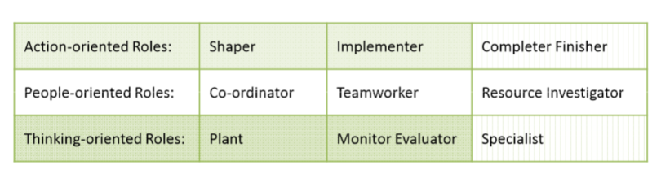
Belbin’s Team Roles
Team Role:“A tendency to behave, contribute, and interrelate with others in a particular way.”(Meredith Belbin)
http://www.belbin.com

Slide 15
Belbin's Team Role Theory
Dr R.Meredith Belbin, a British Researcher identified mainly 3 Team Roles
Action Oriented-
(Shaper, implementer, completer finisher) -
See obstacles as challenges, courageous to push things, extroverted and stimulate others.
They put ideas and concepts into practical actions.
Disciplined, work systematically and efficiently, perfectionist but may be inflexible and sometimes reluctant to delegate and may insult others feelings.

Slide 16
cont.
People Oriented-
(Coordinator, Team worker, Resource Investigator)
Supportive and caring to the people. negotiator, flexible
Diplomatic and popular but poor at making difficult decisions.
Extroverted, overly optimistic but lose enthusiasm quickly

Slide 17
cont.
Thought Oriented-
(Plant, Monitor Evaluator, Specialist)
Bring new ideas and concepts, innovators, knowledgeable, pride themselves for their ability, introverted, impractical, poor communicators
Carefully weigh pros and cons, critical thinker, unemotional to others.
Tend to be single-minded and professional.

Slide 18
Problems with Roles
Role Overload
Role Conflict
Role Ambiguity
Rigidity
Territoriality
Abdication
Human Nature

Slide 19
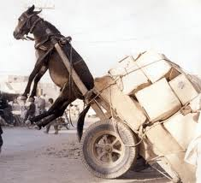
Problems with Roles
Role Overload :
This can leave the member exhausted, attempting to get more done in less time.
Stress builds and productivity falls.
Personal defeat can isolate the member from the group and shatter communication.

Slide 20
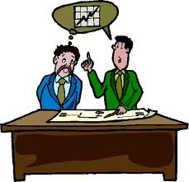
Problems with Roles
Role Conflict :
This is when the members of a group each have a different expectation of another's responsibilities.
This person will feel torn and unable to come to terms with the group identity, which can also occur when there is a moral or ethical dilemma with another of the group.

Slide 21
Problems with Roles
Role Ambiguity :
This is when a role is left too vague or undefined, and the individual does not know what is expected of them by the group.
Members experiencing role ambiguity find their self confidence drops and due to that efficiency slows to a crawl.
Without an identity relative to the other group members, an individual cannot perform and they will often isolate and shy away from the other group members.

Slide 22
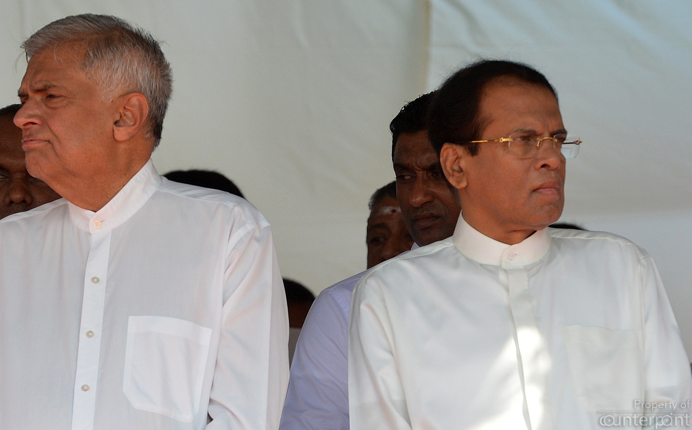
Problems with Roles
Role Ambiguity :
Inter role conflict results from the differing requirements of two or more roles that must be played at the same time.
In 2005, Maithripala Sirisena assumed the presidency in Sri Lanka. Simultaneously, he held the position of Chairman of the SLFF Political Party (Opposition). This dual role created a situation of role ambiguity and led to conflicts with Prime Minister Ranil Wickremesinghe.

Slide 23
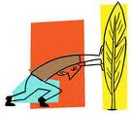
Problems with the Role Concept
Rigidity:
Sometimes prevents flexibility, other potentials

Slide 24
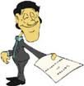
Problems with the Role Concept
Abdication:
Relinquish the duties of a role, creating a gap in teamwork. Avoiding contributing within another’s role just because it is someone else’s responsibility.

Slide 25
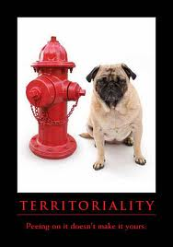
Problems with the Role Concept
Territoriality:
Reluctance to get contribution from others to the role assigned to someone, Guard his role/personal space

Slide 26

Problems with the Role Concept
Human nature:
The annoying habit of being unpredictable, straying from expected role and inconsistency in same role across the individuals

Slide 27
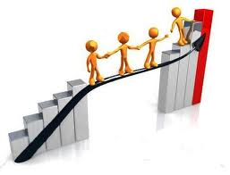
Handling the problems
Solid, unemotional discussion
Role re-delegation until responsibilities have settled comfortably on the correct person.
Self-evaluation and Personality testing can also aid in correct role placement and determination, such as :

Slide 28
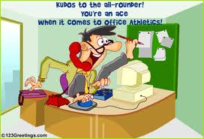
Alternative to the Role Concept
Empowering
Focus on Multiskilling people (all-rounders)

Slide 29
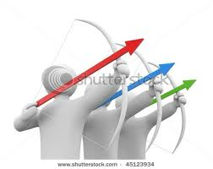
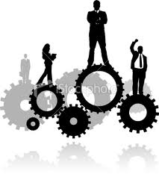
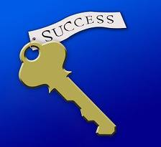
Successful team
Works together toward common goals
Perceive relevance of the group tasks
Mutual respect for members
Diversity of member skills/experience
Individual communication style

Slide 30
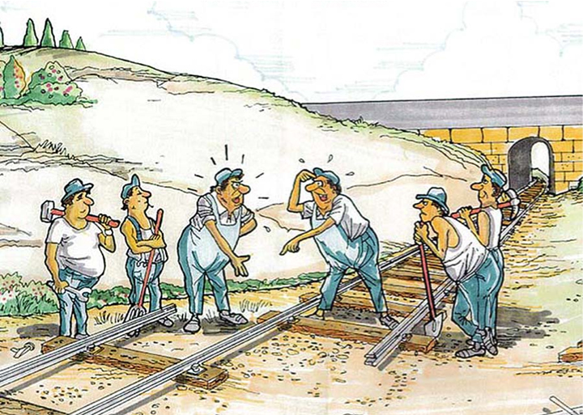
Teamwork ?

Slide 31
Teamwork
“It is the ability to work together toward a common vision. It is the fuel that allows common people to attain uncommon results.”
-Andrew Carnegie

Slide 32
Teams don’t work without teamwork. It is that energy which keeps a team together and makes the teamwork. Unless the players have teamwork skills, they can not perform better.

Slide 33
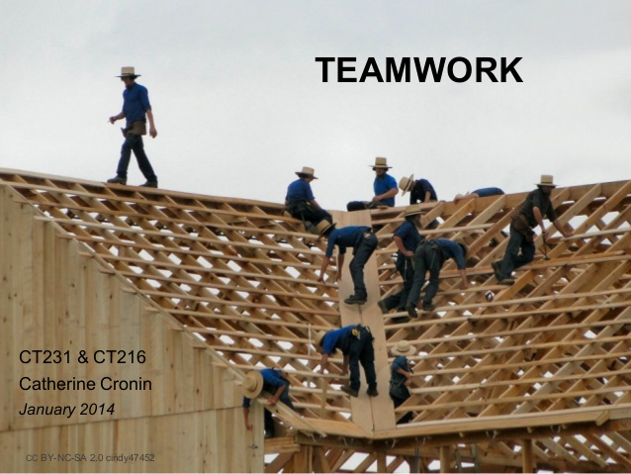
Teamwork is cooperation between members with diverse skills and background to achieve a common goal.

Slide 34
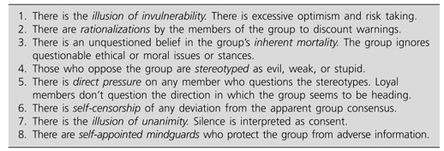
The Dysfunctions of Groups and Teams- Symptoms of Groupthink
What do we as group members do about this?
Video - Groupthink

Slide 35

Conclusion
When people come together as a team, share a dream, and focus on reaching their goals together, there’s a very good chance they’ll accomplish what they set out to do!

Slide 36
Questions ?

